Slide 1


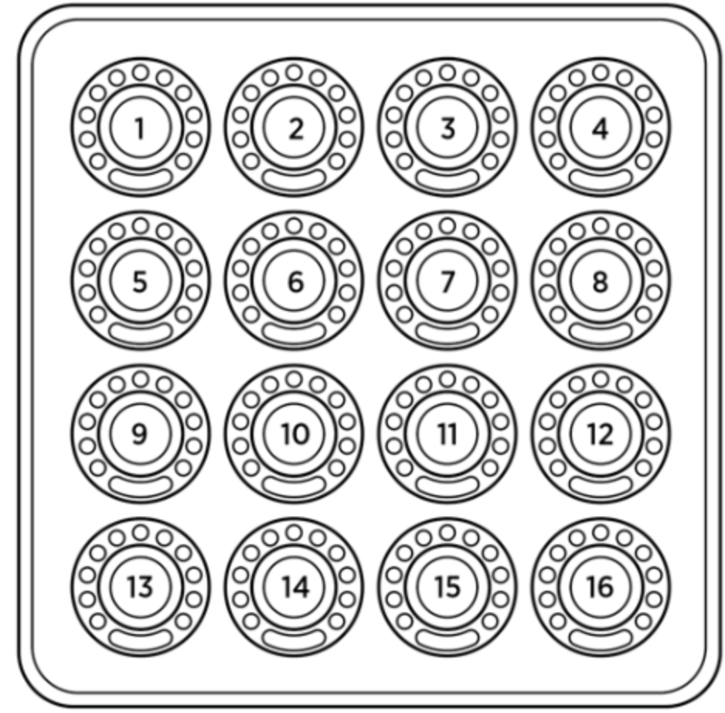
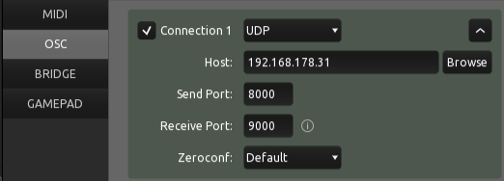
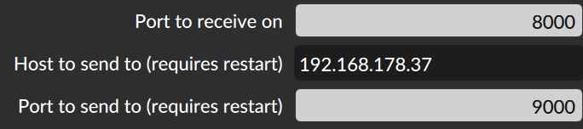
Laptop running Bitwig
Tablet running TouchOSC
Network
IP:192.168.178.31
Port: 8000
IP:192.168.178.37
Port: 9000
USB
Midi Fighter Twister
Configuration in TouchOSC
Configuration in Bitwig Performance Twister

